Slide 1

Earthquake Data Analytics
Presented by Group - 2

Slide 2
Agenda
Understanding Earthquakes
Introduction to Earthquakes
Why are we doing this?
What are we doing?
What we have?
Business Questions

Slide 3
Introduction
Information about real-time earthquakes
Seismicity maps
Tsunami warnings
Type and size of earthquakes experienced over a period of time
Trend analysis
Areas more prone to earthquakes

Slide 4
Why are we doing this?
To provide reliable scientific information to describe, understand & minimize loss of life and property from Earthquakes
To Enhance and protect our quality of life.
To carry out large-scale, multi-disciplinary investigations and provide impartial scientific information to resource managers, planners, and other customers.

Slide 5
What are we doing?
Analyze data and mapping the fast-moving tectonic faults in the world.
We monitor and report earthquakes, assess earthquake impacts and hazards, and research the causes and effects of earthquakes and tsunamis.

Slide 6

What we have?
Real-time data taken from the government website.
Data in JSON format

Slide 7
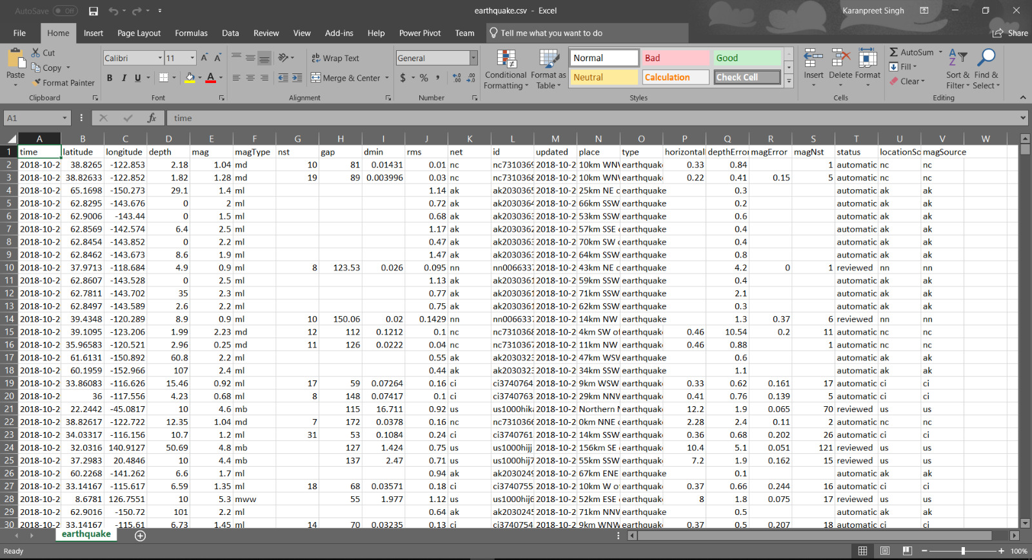
Dataset screenshot

Slide 8
Data Handling
The database is automatically updated every 24 hours for the monthly and weekly database.
The database is also updated every 5 minutes for live data.
Maintaining historical data for future scope (forecasting and developing prediction model).

Slide 9
Source
USGS collects, monitors, analyzes, and provides science about natural resource conditions, issues, and problems.
https://earthquake.usgs.gov/earthquakes/feed/v1.0/geojson.php

Slide 10
Metadata
magnitude
depth
place
time
tsunami
alert
status
latitude
longitude and so on.

Slide 11
Business questions
Earthquake Trends
Areas most affected by Earthquake
Areas with the greatest intensity of an earthquake
Find specific locations where earthquake leads to Tsunami
Earthquake in last 30 days

Slide 12
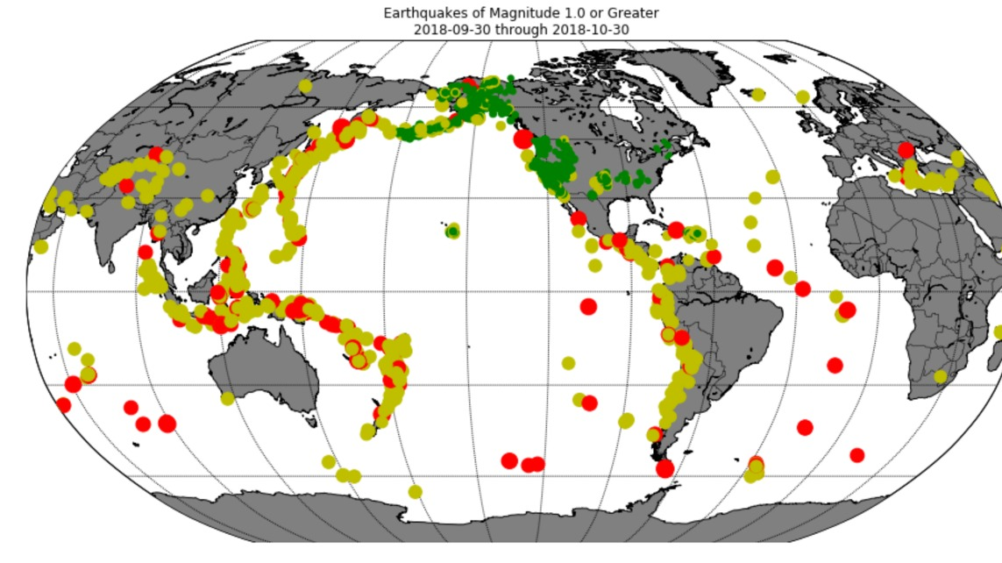
Earthquake Trends
Red – with greater magnitude
Yellow – moderate magnitude
Green – low magnitude

Slide 13
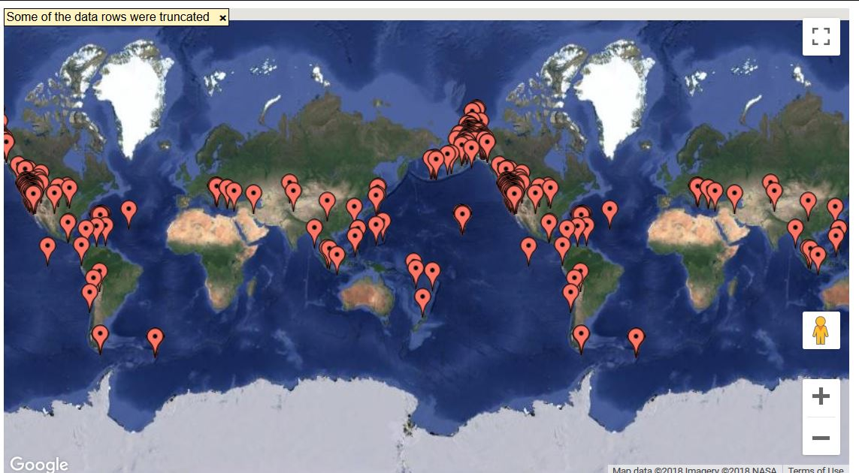
Areas most affected by Earthquake
we will show you live demo

Slide 14
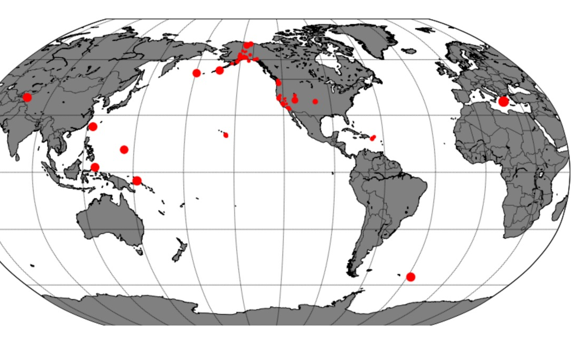
Areas with the greatest intensity of an earthquake
Areas with intensity levels
Greater > 6

Slide 15
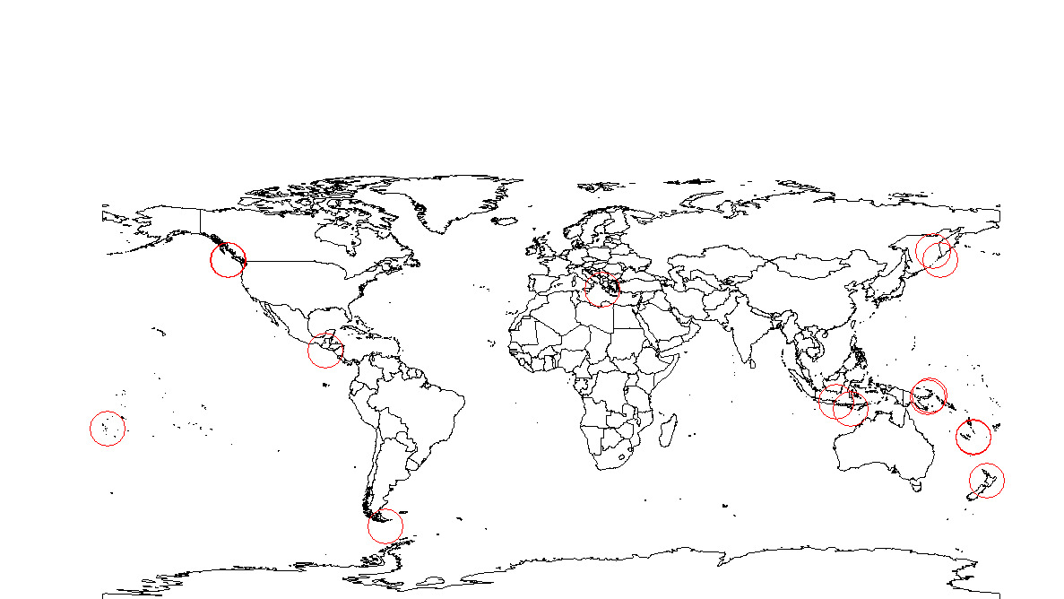
Find specific locations where earthquake leads to Tsunami.

Slide 16
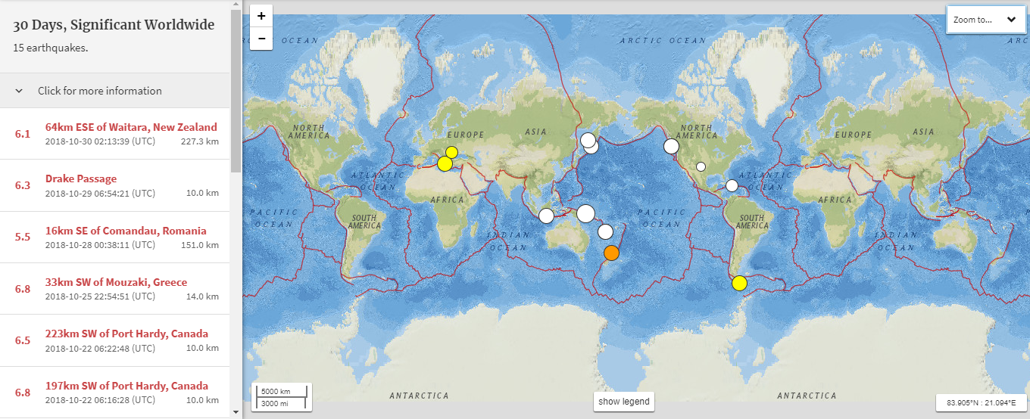
Earthquakes in last 30 days

Slide 17
Thank you

